Slide 1
New York Taxi Data Analysis
fujiayuan0418@gmail.com
Shampa Shahriyar (shampa077@gmail.com)

Slide 2
Dataset Analysis and Visualization
Target :
Analysis 2389990 ( around 2.4 millions) taxi trip data in New York city for January 2016 (1st to 29th) based on duration, fare, distance, day, hour
Predict fare, tip amount based on previous trips and assumption about income
Anomalies in Data:
'fare_amount’ was negative for some entries
'passenger_count’ was zero for some entries
'trip_duration’ was negative for some entries
'trip_distance’ was negative for some entries
Some geolocation values were zero and pickup and drop-off location was same for some entries
Raw data was cleaned up to remove those anomalies

Slide 3
Dataset Analysis and Visualization
General Information :
Total 19 different information is listed for each trip
4 calculated fields are used for improved feature
Cleaned up data has 2292739 entries
Tools for analysis:
Python
SQL
Tableau

Slide 4
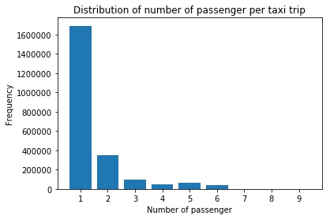
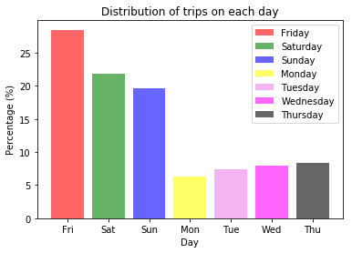
Number of Passengers Per Trip and Busy Day of The Week

Slide 5
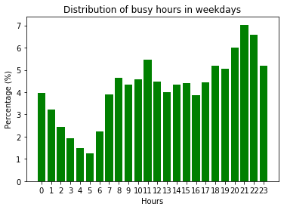
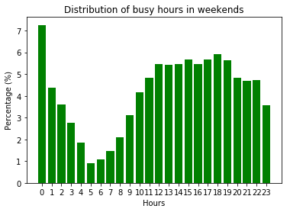
Busy Hours
For weekdays people are using taxi service on night
For weekend as people are outside up to midnight (0 hour), they prefer taxi service.

Slide 6
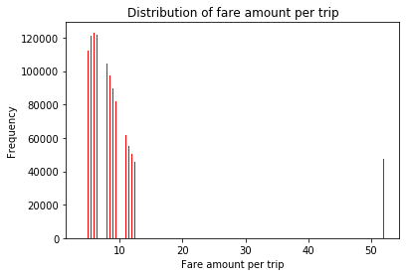
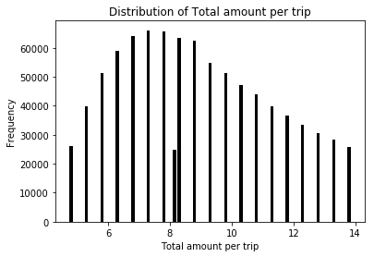
Fare for Trip
Popular fare amount is between 5.5 to 7 dollar which indicates short journey is popular. In graph only prominent fare ranges are included
In graph only prominent total fare ranges are included

Slide 7
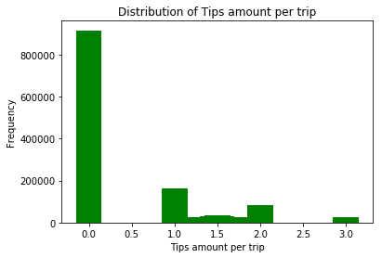
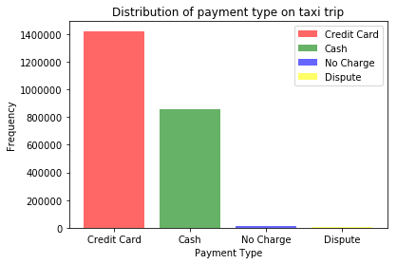
Tips and Payment Mode
It indicates as payment mode vis card is popular, people are less interested to pay any tips. Cash tips information is not included in data

Slide 8
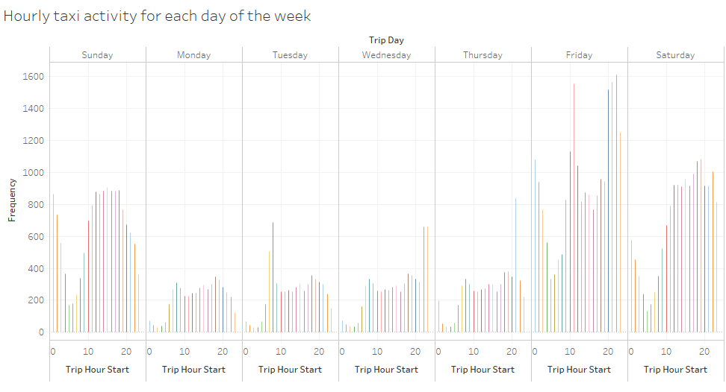
Hourly Taxi Activity for each day of the week
Friday and Weekends are more busy in New York

Slide 9
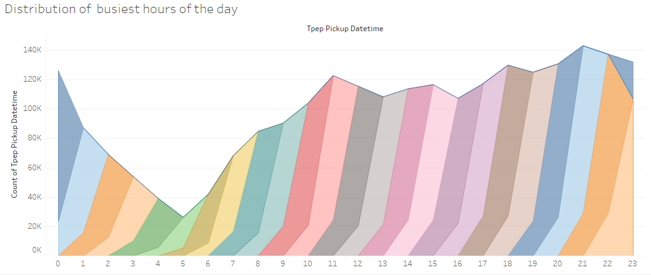
Traffic Transition
Areas are showing start and end of journey

Slide 10
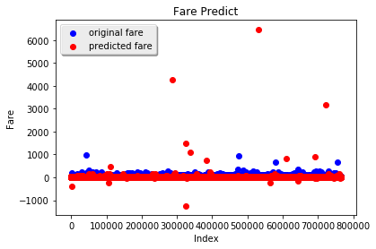
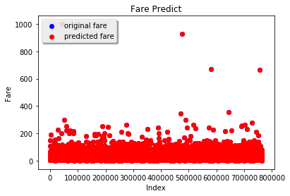
Fare Prediction
Independent Variable: 'trip_day' ,'pickup_longitude','pickup_latitude’, 'dropoff_longitude’, 'dropoff_latitude’, 'trip_hour_start', 'trip_hour_end’
MSE: 168.76392978649073
Taking all features in consideration
MSE:6.1645901073485954e-20

Slide 11
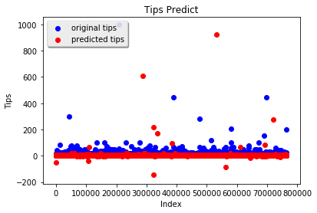
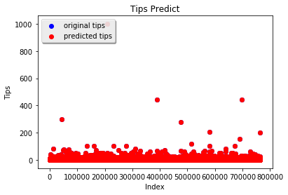
Tips Prediction
Independent Variable: 'trip_day' ,'payment_type','pickup_longitude','pickup_latitude','dropoff_longitude’, 'dropoff_latitude', 'trip_hour_start’, 'trip_hour_end'
MSE: 6.9504571333529759
Taking all features in consideration
MSE:6.164808634283238e-20

Slide 12
Thank you

